Slide 1
ICS 218 -Multimedia Systems and Applications
Lecture 4 - JPEG Compression
Prof. Nalini Venkatasubramanian
nalini@ics.uci.edu

Slide 2
Introduction
  Requirements on JPEG implementations
  JPEG Image Preparation
      Blocks, Minimum Coded Units (MCU)
  JPEG Image Processing
      Discrete Cosine Transformation (DCT)
  JPEG Quantization
      Quantization Tables
  JPEG Entropy Encoding
      Run-length Coding/Huffman Encoding

Slide 3
Additional Requirements -JPEG
  JPEG implementation is independent of image size and applicable to any image and pixel aspect ratio.
  Image content may be of any complexity (with any statistical characteristics).
  JPEG should achieve very good compression ratio and good quality image.
  From the processing complexity of a software solution point of view: JPEG should run on as many available platforms as possible.
  Sequential decoding (line-by-line) and progressive decoding (refinement of the whole image) should be possible.

Slide 4
Variants of Image Compression
Four different modes
    Lossy Sequential DCT based mode
      Baseline process that must be supported by every JPEG implementation.
    Expanded Lossy DCT based mode
      enhancements to baseline process
    Lossless mode
      low compression ratio
      allows perfect reconstruction of original image
    Hierarchical mode
      accomodates images of different resolutions

Slide 5
JPEG Processing Steps
Uncompressed
Image
Baseline
Sequential
Mode
Expanded
Lossy
Mode
Lossless
Mode
Hierarchical
Mode
Image
Preparation
Pixel,
Block, MCU
Block, MCU
8bits/pixel
12 bits/pixel
2-16 bits/pixel
Image
Preparation
Predictive
Entropy
coding
Transformation
Source Coding
lossy DCT
Layered
coding
Switch
between
lossy DCT and
lossless
technique
Prediction
FDCT
Quantization
Compressed
Image
Entropy
Encoding
Run-length
Huffman
Run-length
Huffman
Arithmetic

Slide 6
Image Preparation (General Image Model)
  The image preparation model in JPEG is very general.
    It is not based on
      9-bit YUV encoding
      fixed number of lines, columns
      mapping of encoded chrominance
  It is independent from image Parameters such as image size, image and pixel ratio.
  Source image consists of 1 to 255 components (planes).
    For example, each component Ci (1≤ i ≤ 255) may be assigned to YUV, RGB or YIQ signals.

Slide 7
Image Preparation
Ci
Xi
Cn
...
Yi
C2
C1
Division of the source image into planes

Slide 8
Image Preparation (cont.)
  Each pixel is presented by ‘p’ bits, value is in the range of (2^p -1).
  All pixels of all components within the same image are coded with the same number of bits.
    Lossy modes of JPEG use precision of 8-12 bits per pixel.
    Lossless mode uses precision of 2 up to 12 bits per pixel.
    If JPEG application makes use of any other number of bits, then application must perform a suitable image transformation to the well-defined number of bits/pixel (JPEG standard).

Slide 9
Components and Resolutions
Components with the same resolution
X1
X2
X3
Y1
A1
A2
B1
B2
C1
C2
Y2
X1 = X2 = X3
Y3
Y1 = Y2 = Y3
An
Bn
Cn
RGB - 3 equal components
Components with different resolution
Gray Scale has a single component
X1
X2
X3
A1
A2
B1
B2
C1
C2
X1 = 2X2 = 2X3
Y1
Y2
Y3
Y1 = Y2 = Y3
YUV color image processing uses
An
Bn/2
Cn/2
X1 = 4X2 = 4X3
Y1 = 4Y2 = 4Y3

Slide 10
Image Preparation
(Dimensions of a Compressed Image)
  We define
    X_max = max(X_i)
    Y_max = max(Y_i)
    H_i - relative horizontal sampling ratio for each component, where ⎡X_i = X_max × H_i/H_max⎤
    V_i - relative vertical sampling ratio for each component, where ⎡Y_i = Y_max × V_i/V_max⎤
      H_i, V_i are integers and in the range of [1,4]. This definition is needed for interleaving of components.
    Consider the following example
      Let Y_max = 4 pixels, X_max = 6 pixels.

Slide 11
Components and Resolutions
Level 0
H_0 = 2 (X = 6)
V_0 = 2 (Y = 4)
Level 1
H_1 = 2 (X = 6)
V_1 = 1 (Y = 4/2)
Level 2
H_2 = 1 (X = 6/2)
V_2 = 1 (Y = 4/2)
C_0
*
*
*
*
*
*
C_1
C_2
*
*
*
*
*
*
*
*
*
*
*
*
*
*
*
*
*
*
*
*
*
*
*
*
*
*
*
*
*
*
*
*
*
*
*
*
Y_max = 4 pixels, X_max = 6 pixels

Slide 12
Image Preparation (Blocks)
  Images are divided into data units, called blocks
    Lossy modes operate on blocks of 8X8 pixels.
    Lossless modes operate on data units equal to 1 pixel.
    DCT transformation operates on blocks.
  Data units are processed component by component and passed to image processing.
  Processing of data units per component can be
    Non-interleaved data ordering
      Left to right, top to bottom
    Interleaved data ordering

Slide 13
Image Preparation
(Minimum Coded Units - MCUs)
  Interleaved Data units of different components are combined to minimum coded units (MCUs).
    If image has the same resolution, then MCU consists of exactly one data unit for each component.
      Decoder displays the image MCU by MCU.
    If image has different resolution for single components, then reconstruction of MCUs is more complex.
      For each component, determine regions of the data units. Each component has same number of regions, MCU corresponds to one region.
      Data units in a region are ordered left-right, top-bottom
      Build MCU
    JPEG standard - only 4 components can be encoded in interleaved mode
    Bound on length of MCU
      MCU consists of at most 10 data units.

Slide 14
Image Preparation
(MCU Example)
  4 components - C1, C2, C3, C4
      C1: H_1 = 2, V_1 = 2
      C2: H_2 = 2, V_2 = 1
      C3: H_3 = 1, V_3 = 2
      C4: H_4 = 1, V_4 = 1
  The considered individual elements of the components are denoted as.
C1:
d
1
...
d
1
00
31
C2:
d
2
...
d
2
00
11
C3:
d
3
...
d
3
00
30
C4:
d
4
...
d
4
00
10

Slide 15
Image Preparation
(MCU Example)

Slide 16
Image Preparation
After image preparation,
  uncompressed image samples are grouped into data units of 8x8 pixels and passed to the JPEG encoder
    order of the data units is defined by the MCUs
    precision 8 bits/pixel represents the baseline mode
    values are in the range of [0,255];

Slide 17
Image Processing
First step:
  pixel values are shifted (ZERO-SHIFT) into the range [-128,127] with 0 in the center.
    Values in the 8x8 pixel are defined by S_yx with y,x in the range [0,7] and there are 64 sampled values S_yx in each block.
  DCT maps values from time to frequency domain.
    1D Forward Discrete Cosine Transformation
    2D Forward Discrete Cosine Transformation

Slide 18
Image Processing (DCT)
1D Forward Discrete Cosine Transformation
cos(
)
S(x) - 1D sampled value
C(u) - scaling coefficient
S(u) - 1D DCT coefficient
(transforms S(x) into
frequency domain)
7
(2x+1)uπ
S(u) =
C(u)
∑
—
—
S(x)
2
x=0
16
2D Forward Discrete Cosine Transformation
cos(
)
cos(
)
1
7
7
(2x+1)uπ
(2y+1)vπ
S(v,u) =
—
C(u)C(v)
∑
∑
S(y,x)
—
—
4
x=0
y=0
16
16
C(u), C(v) = 1/√2 for u,v = 0, C(u), C(v) = 1 otherwise
S(y,x) - 2D sampled values
C(u),C(v) - scaling coefficients
S(v,u) - 2D DCT coefficients
7

Slide 19
Image Processing (DCT)
  S(v,u) coefficients:
      S(0,0) includes the lowest frequency in both directions and it is called the DC coefficient. S(0,0) determines the fundamental color of the BLOCK(64 pixels). For this coefficient the frequency is equal 0 in both directions.
      S(0,1)…S(7,7) are called AC coefficients. Their frequency is non-zero in one or both directions. There exist many AC coefficients with a value around 0.
  Factoring
      By computing the DCT coefficients, we can use factoring; the problem will be reduced to a series of 1D FDCTs.
cos(
)
(
cos(
)
)
7
7
(2y+1)vπ
1
(2x+1)uπ
∑
—
S(y,x)
S(v,u) =
—
∑
C(u)
—
C(v)
4
x=0
16
y=0
16

Slide 20
Image Processing (IDCT)
  Inverse Discrete Cosine Transformation(IDCT)
      The inverse conversion from DC coefficients to sampled values
    In theory, if FDCT and IDCT could be calculated in full precision, then they would lead to lossless compression.
    In practice, precision is restricted and DCT is lossy.
      JPEG does not define any precision parameters, therefore there exist various implementations.

Slide 21
Quantization
GOAL: To throw out bits.
    Example:
      101101 = 45 (6 bits).
      We can truncate this to 4 bits: 1011 - 11
      or 3 bits 101 = 5 (original value - 40) or 110 = 6 (value = 48)
    Uniform quantization is achieved by dividing the DCT coefficient value S(v,u) by N and rounding the result.
    In S(v,u) how many bits do we throw away?
    ANSWER: Use quantization tables

Slide 22
Quantization Tables
  Quantization tables consist of 64 elements
      Each value is 8 bits - Q_vu
    Using quantization tables we get new compressed values
      Sq_vu = S_vu / Q_vu for each u,v in range [0,7]
    Dequantization must use the same tables.
    Standard defines 2 default quantization tables, one for luminance and one for the 2 chrominance components.
    Custom Quantization tables can be put in the image/scan headers.

Slide 23
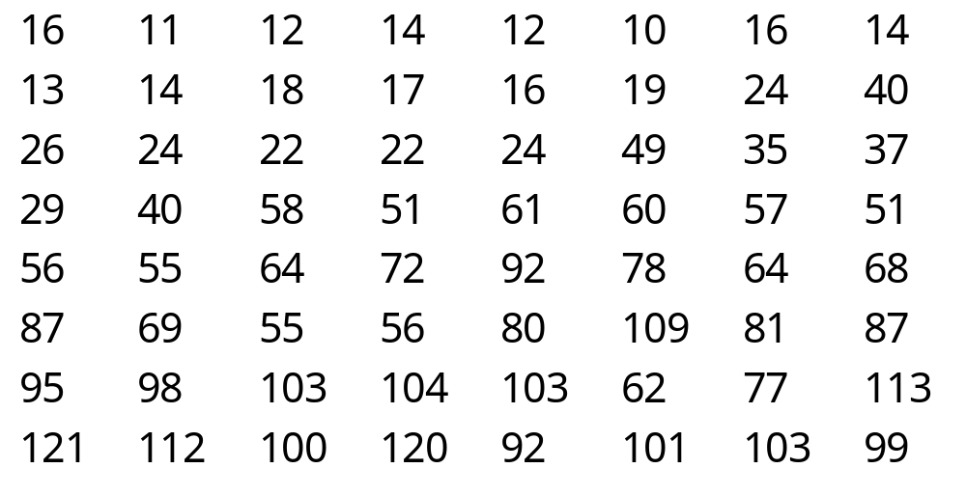
Example:
Luminance Quantization Table
Eye is most sensitive to low frequencies (upper left corner), less sensitive to high frequencies (lower right corner)

Slide 24
Entropy Encoding
  After image processing we have quantized DC and AC coefficients.
  Initial step of entropy encoding is to map 8x8 plane into 64 element vector
.
.
.
Zig zag scan

Slide 25
Entropy encoding
DC Coefficient Processing
  Treat quantized DC coefficients separately from AC coefficients.
    DC coefficients determine the basic color of the data unit.
    DC coefficient is large and varied, but often close to previous value.
    Use difference encoding.
DC0
DC1
DC2
Diff_i = DC_i - DC_(i-1) ; i> 0
DC0
Diff1
Diff2
DC3
DC4
DC5
Diff3
Diff4
Diff5
DC6
DC7
DC8
Diff6
Diff7
Diff8

Slide 26
Entropy Encoding
AC Coefficient Processing
  DCT processing of AC coefficients
    follows zig-zag sequence which means that the coefficients with lower frequencies are encoded first, followed by higher frequencies.
    Implies that we can get a sequence of similar data bytes, hence can apply entropy encoding.
    JPEG standard specifies Huffman or Arithmetic encoding, in baseline mode only Huffman Coding is used.
    Arithmetic encoding is protected by patent.

Slide 27
Entropy Encoding (Algorithm)
Apply run-length coding on AC components of zero values (1x64 has many zeros) and encode them as as pairs (skip, values)
Apply Huffman Coding on DC and AC coefficients.

Slide 28
Entropy Encoding
(DC Huffman Encoding)
  Categorize DC values into DC code tables.
    Get difference magnitude categories for DC coefficients (12 possible categories).
    Handle SSSS as Huffman Symbols
      consider symbols p(0)…p(11). Create a Huffman tree and get a Huffman code for SSSS.
      For each category, additional bits field is appended to the code word to uniquely identify which difference in that categories actually occurred.
      Send(Huffman code, actual value).
      Example: If SSSS=2 has the Huffman code 001 and Diff= -3, we send 00100, first 3 bits are Huffman code and last 2 bits represent -3 in 2’s complement.

Slide 29
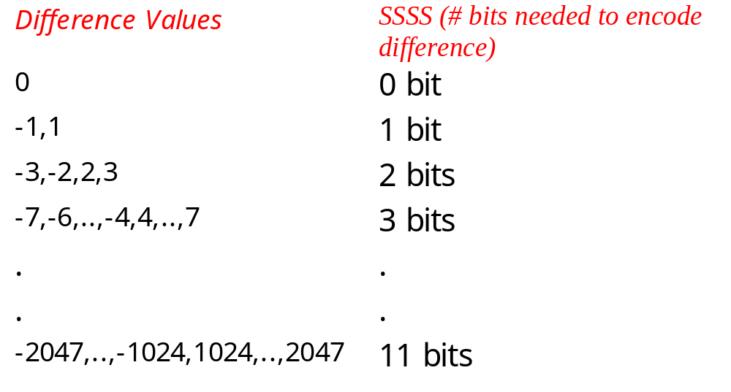
Difference Magnitude Categories

Slide 30
Entropy Encoding
(AC - Huffman Encoding)
  Each non-zero AC coefficient in zigzag scan is described as a composite 8 bit value
    RS = binary ’RRRRSSSS’.
  SSSS defines
      category for the amplitude of the next non-zero coefficient in zig-zag scan.
  RRRR defines
      position of the coefficient in the zigzag scan relative to previous nonzero coefficient (run length coding of 0 coefficients b/w nonzero coefficients).

Slide 31
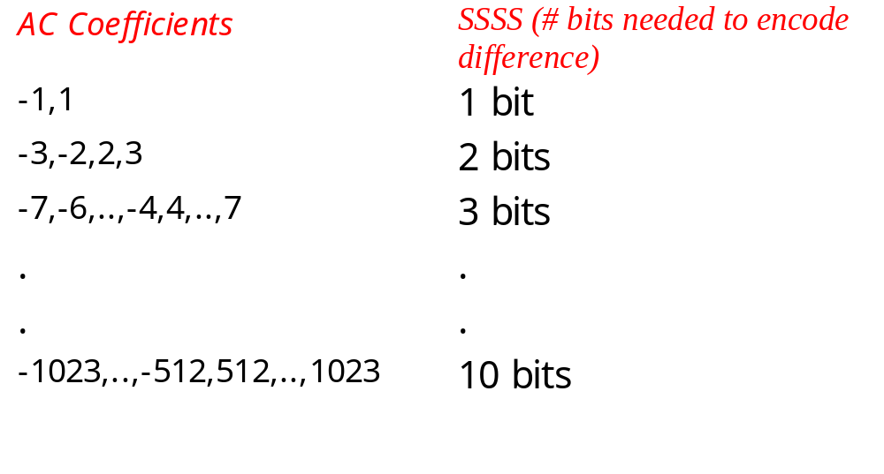
AC Coefficient Categories

Slide 32
JPEG Comments
    Applications do not have to include both an encoder and decoder if the compression and decompression process agree on a common table.
    The encoded data stream has a fixed interchange format:
      encoded image data, chosen parameters, tables of the coding process.
    In regular mode, the interchange format includes all of the information necessary for decoding without any previous knowledge of the coding process.

Slide 33
JPEG Interchange Format
Start-of-Image
Frame
End-of-Image
Tables, etc.
header
Scan
...
Scan
Tables, etc.
header
segment
Restart
segment
Restart
block
block
...
block

Slide 34
JPEG Headers
  JPEG Headers:
    Frame Header -
      sample precision, width and height of image, number of components, unique ID (for each component), horizontal/vertical sampling factors (for each component), quantization table to use (for each component)
    Scan Header
      number of components in scan, component ID for each component, Huffman table for each component.
    Misc
      occurs b/w headers and includes quantization tables, Huffman tables, Arithmetic coding tables, comments, application data.

